Slide 1







NFHS
Tennessee High School Volleyball Score sheet Guide

Slide 2

TSSAA Score Sheet

Slide 3
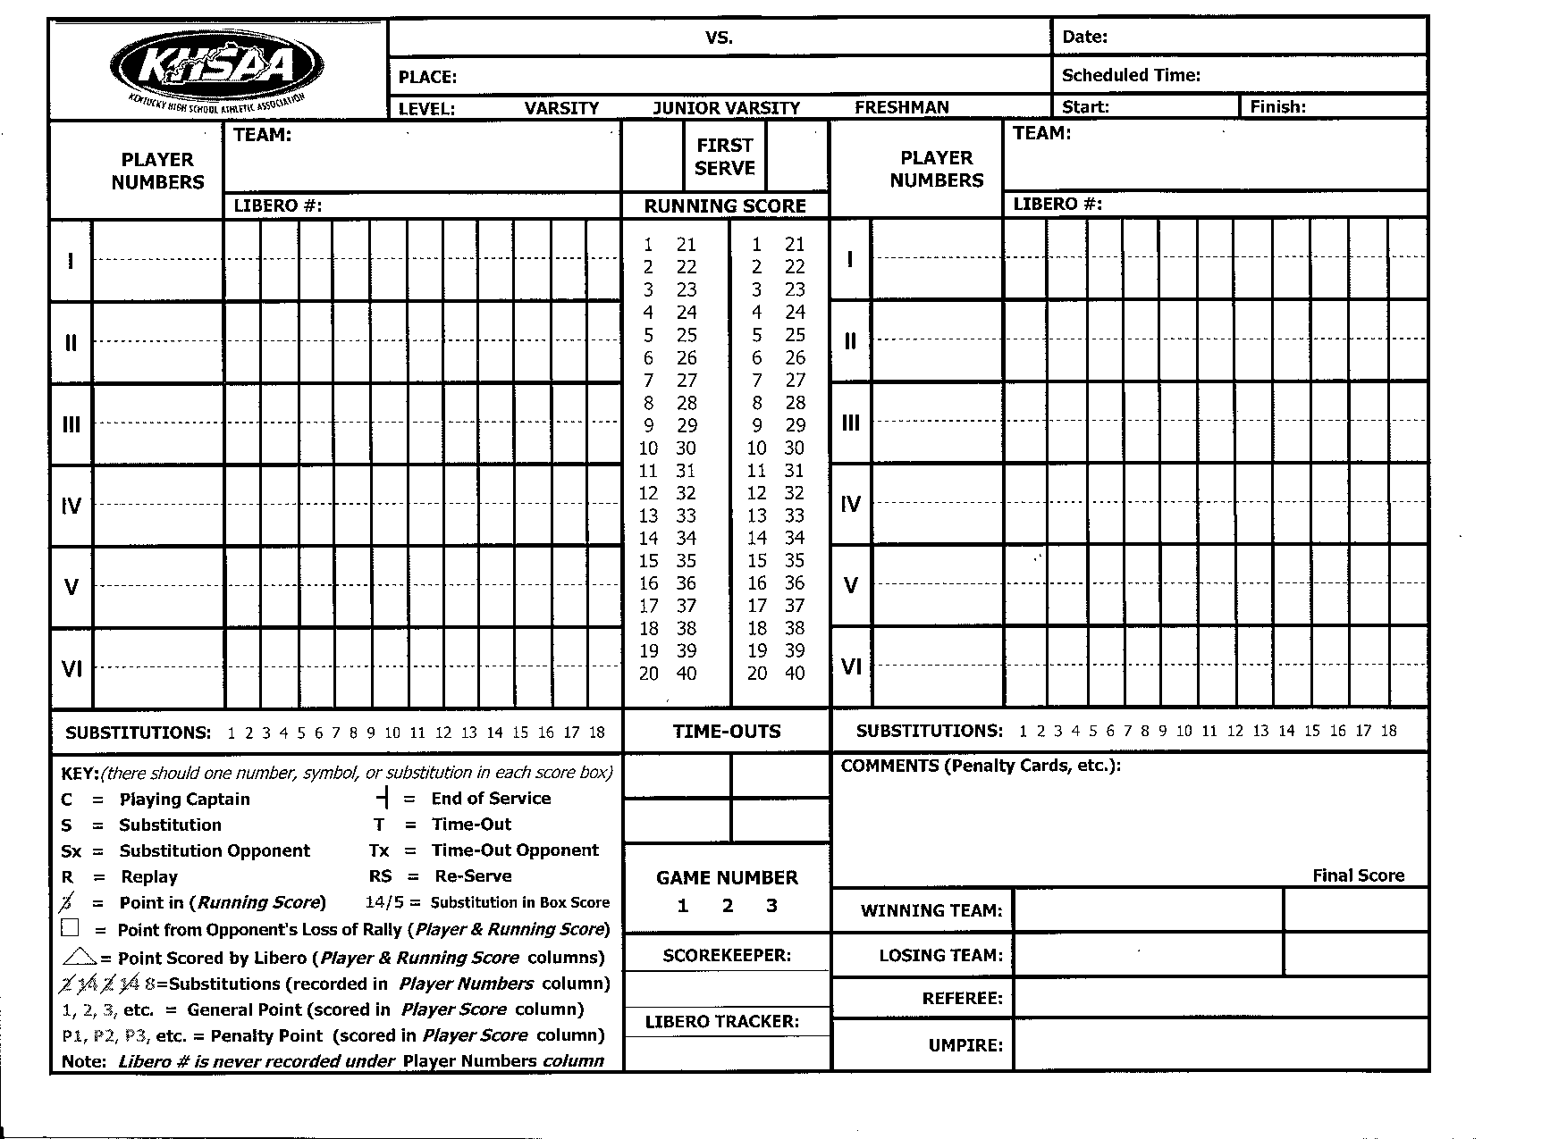

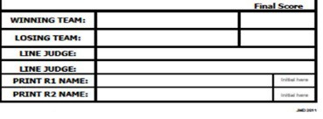

Refer to the bottom left corner of the score sheet. There is a ‘Key’ to all the symbols used during a set.

Slide 4



Complete the top section of the score sheet; fill in names of officials, scorer, libero tracker and line judges.
Visitor playing Home in a scheduled 7:30 pm Varsity Match.
- THIS IS THE FIRST SET OF THE MATCH -
Visitor Home
Home High
9-23-2022
7:30 pm
2 3 4 5
Penny Points
Laura Line Judge
Lenny Line Judge
Wanda Whistle
Tom Toots
Sally Spots

Slide 5
~REMINDERS~
R2 will receive rosters from the coaches
Referee will inform the scorer which bench the home team has selected.
Scorer will write the team names on the score sheet according to the side the team will be on during the set (game).
After the coin toss the referee will inform the scorer of which team will be serving first. R2 will provide rosters to the scorer.

Slide 6

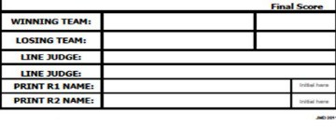

Team names are written on the score sheet based on where the teams are on the court. In this set, Visitor is on the scorer’s left and Home is on the scorer’s right.
Visitor will have first serve. Place an ‘X’ in the First Serve box.
Visitor Home
Home High
9-23-2022
7:30 pm
Visitor
X
Home
2 3 4 5
Penny Points
Laura Line Judge
Lenny Line Judge
Wanda Whistle
Tom Toots
Sally Spots

Slide 7
For the second set of the match the teams will switch sides.
Team names are again written on the score sheet based on where the
teams are on the court. This time, Home would serve first.
Visitor Home
Home High
9-23-2022
7:30 pm
Home
X
Visitor
2 3 4 5
Penny Points
Laura Line Judge
Lenny Line Judge
Wanda Whistle
Tom Toots
Sally Spots

Slide 8
Referee will collect the line up sheets from each team. Coach must indicate Captain [c] next to a player’s number on the lineup.
Scorer records the numbers of the starting players of each team on the score sheet from the line up sheet submitted – under Player Number.
Each square on the score sheet represents one play or action such as a serve, substitution or a time out.

Slide 9
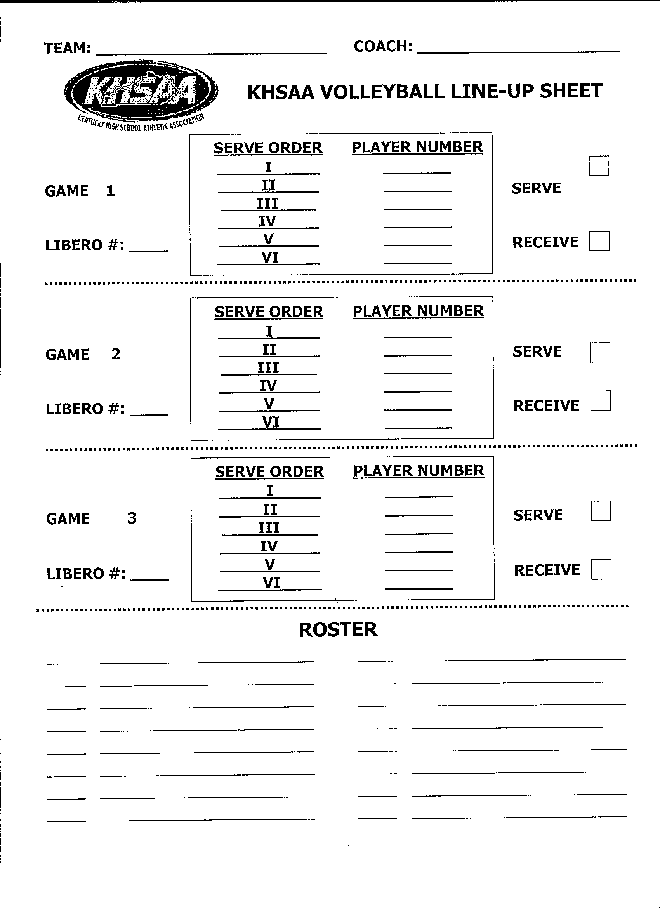
Visitor
Bob Smith
Line Up Sheet
I = 1st server
II = 2nd server, etc.
Does not matter if the team is serving first or receiving first
5
4
3
12c 11
10
X
7
Note the libero #
Roster for player numbers and
names

Slide 10
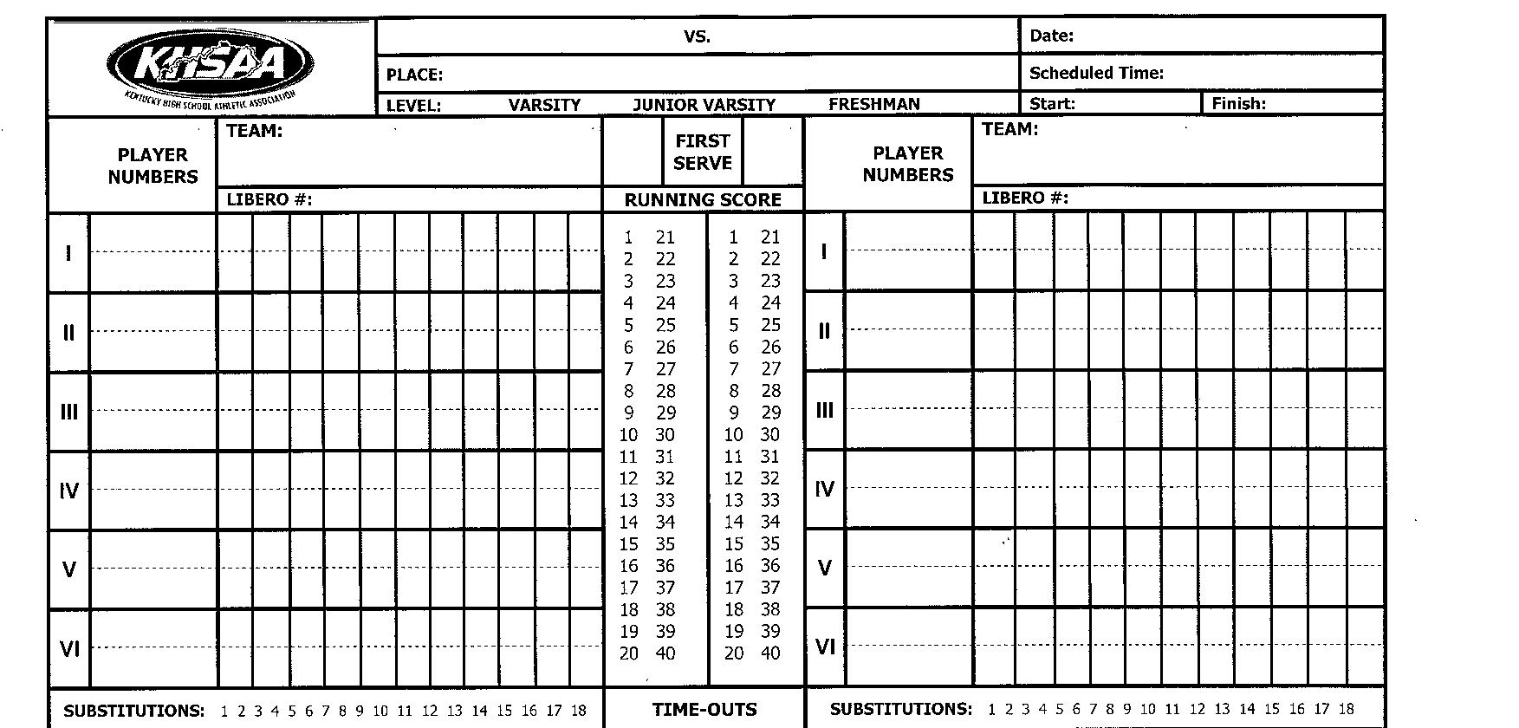
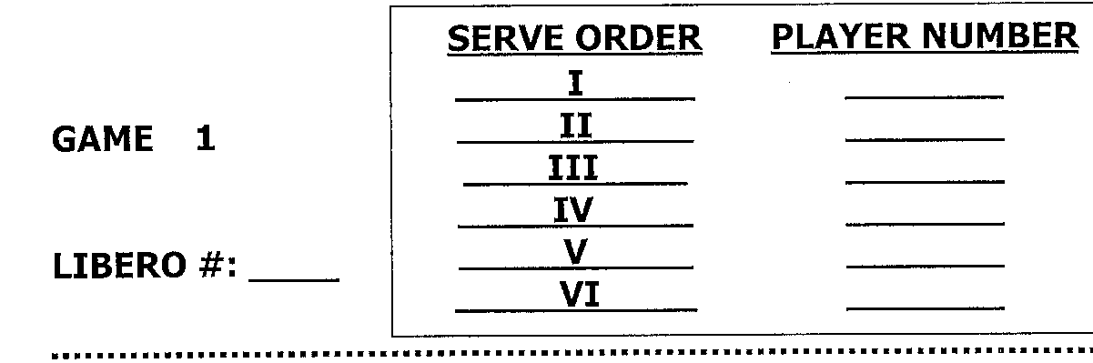
Player numbers are written by serving order with first server listed first Since Home is receiving when the teams line up on the court,
#23 will be the right front position on the court.
Visitor Home
Home High
9-23-2022
7:30 pm
Visitor
X
Home
5
4
3
12c
11
10
23
24c
26
20
21
22
Visitor line up sheet
Home Line up sheet
5
4
3
12c 11
10
23
24c 26
20
21
22
7
30

Slide 11
Libero number for each team is written in appropriate space.
Visitor
Home High
Home
9-23-2022
7:30 pm
Visitor
X
Home
30
7
5
4
3
12c
11
10
23
24c
26
20
21
22
Visitor line up sheet
Home Line up sheet
5
4
3
12c 11
10
23
24c 26
20
21
22
7
30

Slide 12
Write start time when set begins.
Visitor #5 serves 3 points. Write in the points on #5 service line as they are scored and slash each point in the running score column when scored.
Visitor Home
Home High
9-23-2022
7:30 pm
7:30 pm
Home
30
Visitor
7
X
5
4
3
12c
11
10
1 2 3
23
24c
26
20
21
22
2 3 4 5
Penny Points
Laura Line Judge
Lenny Line Judge
Wanda Whistle
Tom Toots
Sally Spots

Slide 13
The running score column is marked as the game progresses.
When there is a discrepancy between the running score column and the individual scores, the individual score is considered official.

Slide 14
Visitor #5 next serve results in a loss of rally. This is marked with an “-l” in the next box showing end of service.
Visitor Home
Home High
9-23-2022
7:30 pm
7:30 pm
Home
30
Visitor
7
X
5
4
3
12c
11
10
1 2 3 -l
23
24c
26
20
21
22
2 3 4 5
Penny Points
Laura Line Judge
Lenny Line Judge
Wanda Whistle
Tom Toots
Sally Spots

Slide 15
Home will receive a loss of rally point.
A point is placed on the line of the next scheduled server.
All points earned from the opponent's loss of rally are placed in a square.
Visitor Home
Home High
9-23-2022
7:30 pm
7:30 pm
Home
30
Visitor
7
X
5
4
3
12c
11
10
1 2 3 -l
23
24c
26
20
21
22
1
2 3 4 5
Penny Points
Laura Line Judge
Lenny Line Judge
Wanda Whistle
Tom Toots
Sally Spots

Slide 16
Be sure the correct player number is serving!
Check the player # every time a server goes
back to serve.
If an incorrect player is serving and makes contact with the ball, notify the referee verbally at the next dead ball.
Remember: the player is not considered the wrong server until the ball is contacted for serve.

Slide 17
Home serves and loses the rally.
Place the loss of rally/end of service mark.
Give the loss of rally point to the Visitor team.
Visitor Home
Home High
9-23-2022
7:30 pm
7:30 pm
Home
30
Visitor
7
X
5
4
3
12c
11
10
1 2 3 -l
23
24c
26
20
21
22
1
-l
4
2 3 4 5
Penny Points
Laura Line Judge
Lenny Line Judge
Wanda Whistle
Tom Toots
Sally Spots

Slide 18
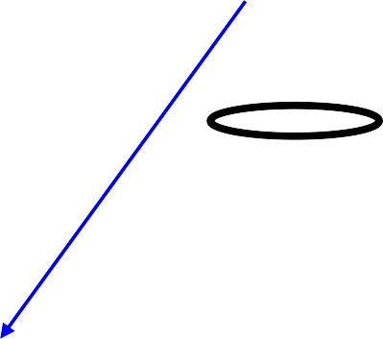
Visitor #4 serves before the referee signals for serve.
A “Replay” is given. An “R” is placed in the service box.
Visitor
Home High
Home
9-23-2022
7:30 pm
7:30 pm
Home
30
Visitor
X
5
4
3
12c
11
10
7
1 2 3 -l
R
23
24c
26
20
21
22
-l
1
4
2 3 4 5
Penny Points
Laura Line Judge
Lenny Line Judge
Wanda Whistle
Tom Toots
Sally Spots

Slide 19


Visitor #4 serves two points. Home request a substitution: #25 for #23.
On the service line write “Sx” for substitution opponent, the number of the player coming in before “/” then the player number leaving. The player number coming in is then written in the ‘players numbers’ column by the player number leaving the game. Slash the #1 in the substitutions section.
Visitor Home
Home High
9-23-2022
7:30 pm
7:30 pm
Home
30
Visitor
7
X
5
4
3
12c
11
10
1 2 3 -l
23,25
24c
26
20
21
22
1
-l
R
5 6 ²⁵/23
4
Sx
2 3 4 5
Penny Points
Laura Line Judge
Lenny Line Judge
Wanda Whistle
Tom Toots
Sally Spots

Slide 20
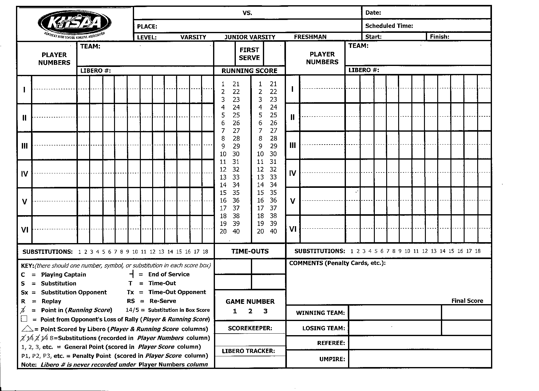


Visitor serves 2 more points. A Red Card Penalty is given to Visitor #3. A comment is written in the COMMENTS section and Visitor loses the serve. “P” is written on the service line of the Visitor team showing the penalty and circled. Service ends, indicated by –l. In this case, the point on HOME side is also squared due to it being a loss of rally point by the opponent.
NOTE: The point is CIRCLED in the running score.
Visitor Home
Home High
9-23-2022
7:30 pm
7:30 pm
Home
30
Visitor
7
X
5 | 1 | 2 | 3 -l
4 | 4 | R | 5 6
11
10
23,25
24c
26
20
21
22
1
-l
Sx
23 7 8
P
-l
P-2
25
/
3
12c
RC #3 Visitor(8-1)
2 3 4 5
Penny Points
Laura Line Judge
Lenny Line Judge
Wanda Whistle
Tom Toots
Sally Spots

Slide 21
Reminders
Write & circle in P–l when a serving team is given a penalty point and thus, loses its serve; this goes into the same square to indicate loss of rally due to the penalty.
Write, circle and square in P2 (ex: team is awarded the 2nd point) when opponent is given a penalty point.
Penalty points [RUD & RC] are circled only in the running score.

Slide 22
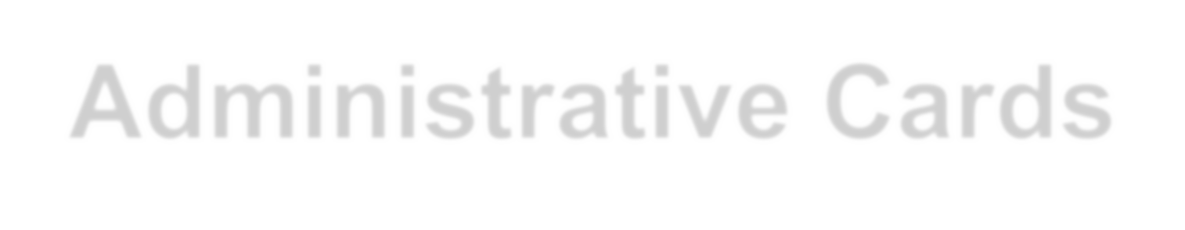




WHAT GOES IN THE COMMENTS SECTION?
Administrative Cards
Unnecessary Delay (Yellow Card First Offense in set
  YUD, team name (if only have one comment section), then team score (team score with offending team listed first).
Unnecessary Delay (Red Card) Second Offense in same set
  RUD #of player or C for coach, (team score with offending team listed first).
  Loss of rally/point awarded to opponent.

Slide 23
Administrative Delays
Not immediately ready to start play when directed.
A substitute attempting to enter or a player in the set with illegal equipment/uniform.
    No restrictions on waist bands
In resuming play, due to coach/captain making
excessive requests for serving order.
Improperly completing substitution or substitute entering court before authorization from referee.
An illegal substitute attempting to enter the set.
An illegal replacement attempting to enter the set once signal for serve has been initiated.
Failure to submit a roster to R2 at pre-match conference.

Slide 24
Administrative Delays (cont.)
Late submission of a team's lineup.
Repeatedly using improper substitution procedure.
Coach does not make decision about injured player within 30 seconds.
In returning to play or cleaning up liquid/other substance after the time out is concluded.
Team conferring during timeout at a location other
than team bench or court area.
Requesting a timeout in a set after taking the allotted two timeouts.
Libero entering court outside the replacement zone.

Slide 25
Administrative Delays (cont.)
Substitution denied by R2 [after the request is recognized] due to an illegal substitution.
Improper request for a substitution, timeout or lineup check that is acknowledged (whistled) by R2.
For Administrative Delay warning [YUD] or
Penalty [RUD], coaches MAY remain standing.
For repeated unnecessary delay violations in multiple sets, unsporting conduct may be issued by the first referee.

Slide 26
WHAT GOES IN THE COMMENTS SECTION?
FOR UNSPORTING CONDUCT:
Warning Yellow Card = YC, #, team name, score
Ex: YC #2 Volley High (7-6) When writing the score, it is the
score at the time the card is given – the team score receiving
the card is placed first, then the other team’s score.
~NO Penalty assessed with a yellow card~
Penalty Red Card = RC #, team name, score
  Ex: RC #9 Volley High (7-16)
~Loss of rally/point awarded to opponent~
Disqualification = Yellow & RED CARD =
  Ex: DQ # 9 Volley High (17-18)
~Loss of rally/point awarded to opponent~

Slide 27
UNCONSCIOUS PLAYER:
Concussion Management
  CM # of player being removed, team name
  EX: CM #15, Volley High 5-3 (Score of set
  with player’s team listed first)
RE-DESIGNATED LIBERO:
  RL # of Libero team name (with score of RL team listed first)
EXCEPTIONAL SUBSTITUTION:
  ES # of player replaced (team score)

Slide 28
Remember:
Only Unsporting Conduct Cards carry over from set to set throughout the match.

Slide 29





Home #24 serves three points. Visitor calls a time out.
“Tx” is written on the service line of the current server when the time out is called.
The score is then written in the time out box on the side of the team calling the time out – the score of the team calling the time out is written first.
Visitor Home
Home High
Visitor X
7
9-23-2022
7:30 pm
7:30 pm
Home
30
5
4
3
12c
11
10
1 2 3 -l
23,25
24c
26
20
21
22
1
-l
3 4 5 Tx
R
5 6 7 8 ^{P}-l
4
Sx
P-2
²⁵/23
8 - 5
RC #3Visitor(8-1)
2 3 4 5
Penny Points
Laura Line Judge
Lenny Line Judge
Wanda Whistle
Tom Toots
Sally Spots

Slide 30




Visitor substitutes #13 for #3.
Home serves three more points.
Visitor Home
Home High
9-23-2022
7:30 pm
7:30 pm
Home
30
Visitor
7
X
5
1 2 3 -l
23,25
1
-l
3 4 5 Tx
6 7 8
Sx
13_{/3}
4 | 4 | R 5 6^{Sx} 7 8 ^{P}-l 24c ^{P-2}
12c
11
10
²⁵/23
3 ,13
26
20
21
22
8 - 5
RC #3Visitor(8-1)
2 3 4 5
Penny Points
Laura Line Judge
Lenny Line Judge
Wanda Whistle
Tom Toots
Sally Spots

Slide 31




Visitor #12 is given a yellow card for misconduct. Notation is only placed in the comment section. Next serve by Home results in a loss of rally.
Give loss of rally point to Visitor.
Visitor Home
Home High
9-23-2022
7:30 pm
7:30 pm
Home
30
Visitor
7
X
5
4
3 ,13
12c
11
10
1 2 3 -l
23,25 ¹ -l
24c
26
20
21
22
R
5 6²⁵/23
7 8 ^{P}-l
3 4 5
Sx
13_{/3}
6 7 8 -l
4
Sx
P-2
Tx
9
8 - 5
RC #3 Visitor (8-1), YC #12 Visitor (8-8)
2 3 4 5
Penny Points
Laura Line Judge
Lenny Line Judge
Wanda Whistle
Tom Toots
Sally Spots

Slide 32


Visitor serves for a loss of rally. Home Libero #30 serves for #26 and scores 2 points.
A Triangle is drawn around the “III” in the service order. This is NOT a substitution…just a reminder that this is the only place the Libero will now be allowed to serve in this set.
A triangle is also drawn around the points scored when the libero serves.
Visitor Home
Home High
9-23-2022
7:30 pm
7:30 pm
Home
30
Visitor
7
X
5
4
3 ,13
12c
11
10
1 2 3 -l
23,25 ¹ -l
24c
26
20
21
22
R
-l
5 6 7 8 ^{P}-l
3 4 5
9 10 11
6 7 8 -l
4
Sx 25/23
P-2
Tx
Sx 13/3
9
8 - 5
RC #3 Visitor(8-1), YC Visitor #12 (8-8)
2 3 4 5
Penny Points
Laura Line Judge
Lenny Line Judge
Wanda Whistle
Tom Toots
Sally Spots

Slide 33


The next serve by Home is a reserve. The ’RS’ would be in the next box. This is in a triangle because it happened while the libero was serving.
Visitor
Home High
Home
9-23-2022
7:30 pm
7:30 pm
Home
30
Visitor
7
1 2 3 -l
Sx
X
5
4
3 ,13
12c
11
10
23,25 ¹ -l
24c
26
20
21
22
4
R
-l
5 6 7 8 ^{P}-l
P-2
3 4 5
Tx
Sx 13/3
6 7 8 -l
25/23
9
9 10 11 ^{RS}
8 - 5
RC #3 Visitor(8-1), YC #12 Visitor(8-8),
RC #12 Visitor (9-11)
2 3 4 5
Penny Points
Laura Line Judge
Lenny Line Judge
Wanda Whistle
Tom Toots
Sally Spots

Slide 34

A penalty point is awarded to Home due to a Red card on Visitor #12.
P is written, then the point awarded. Notice this point is circled in
running & individual scores, as it was not served by the libero.
Visitor Home
Home High
9-23-2022
7:30 pm
7:30 pm
Home
30
Visitor
7
X
5
4
3 ,13
12c
11
10
1 2 3 -l
23,25 ¹ -l
24c
26
20
21
22
R
-l
5 6 7 8 ^{P}-l
3 4 5
6 7 8
-l
4
Sx 25/23
P2
Tx
Sx 13/3
9
9 10 11 ^{RS P12}
8 - 5
RC #3 Visitor(8-1), YC #12 Visitor(8-8),
RC #12 Visitor (9-11)
2 3 4 5
Penny Points
Laura Line Judge
Lenny Line Judge
Wanda Whistle
Tom Toots
Sally Spots

Slide 35



Visitor calls a time out. The score is written in the second Time Out box showing Visitor has no remaining time outs.
Home libero serves point #13, then a loss of rally.
Visitor Home
Home High
9-23-2022
7:30 pm
7:30 pm
Home
30
Visitor
7
1 2 3 -l
Sx
X
5
4
3 ,13
12c
11
10
23,25 ¹ -l
24c
26
20
21
22
4
R
-l
5 6 7 8 ^{P}-l
P2
3 4 5
Tx
Sx 13/3
6 7 8 -l
25/23
9
9 10 11 ^{RS P12} Tx 13 -l
10
8 - 5
9-12
RC #3 Visitor(8-1), YC #12 Visitor(8-8),
RC #12 Visitor (9-11)
2 3 4 5
Penny Points
Laura Line Judge
Lenny Line Judge
Wanda Whistle
Tom Toots
Sally Spots

Slide 36




The set continues……..
Visitor
Home High
Home
9-23-2022
7:30 pm
7:30 pm
Home
30
Visitor
7
X
5
4
3 ,13,3
12c
11
10
1 2 3 -l
23,25 ¹ -l
24c
26
20
21,33
22
R
5 6 7 8 ^{P}-l
3 4 5
6 7 8 -l
4
Sx 25/23
P2
Tx
Sx 13/3
9 -l
9 10 11 ^{RS P12} Tx13 -l
10 111213 -l
14 -l
15 161718 -l
19 -l
S Sx
3/1315 33/21
-l
14
16 17 18 19 -l
8 - 5
9-12
RC #3 Visitor(8-1), YC #12 Visitor(8-8),
RC #12 Visitor (9-11)
2 3 4 5
Penny Points
Laura Line Judge
Lenny Line Judge
Wanda Whistle
Tom Toots
Sally Spots

Slide 37
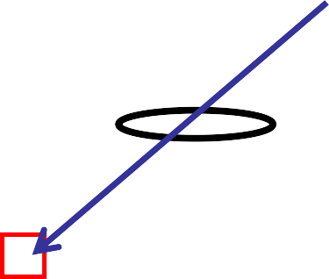




With each service rotation (all six players have served for each team) a different color pen should be used for the next rotation. Start with black (or blue), then red for the 2nd rotation, then black/blue for the 3rd rotation, etc.
Visitor Home
Home High
9-23-2022
7:30 pm
7:30 pm
Home
30
Visitor
7
1 2 3 -l 20 -l
X
5
4
3,13,3
12c 11
10
23,25
24c 26
20
21,33
22
1 -l
R 5 6 25/23 7 8 ^{P}-l
9 -l
3 4 5 6 7 8 -l
4
Sx
P2
Tx
Sx 13/3
9 10 11 RS ^{P12} Tx 13 -l
10 11 12 13 -l
Sx
14 -l
15 16 1718 -l
19 -l
14
S 3/13
15 -l
33/21
16 17 18 19 -l
8 - 5
9-12
RC #3 Visitor(8-1), YC #12 Visitor(8-8),
RC #12 Visitor (9-11)
2 3 4 5
Penny Points
Laura Line Judge
Lenny Line Judge
Wanda Whistle
Tom Toots
Sally Spots

Slide 38
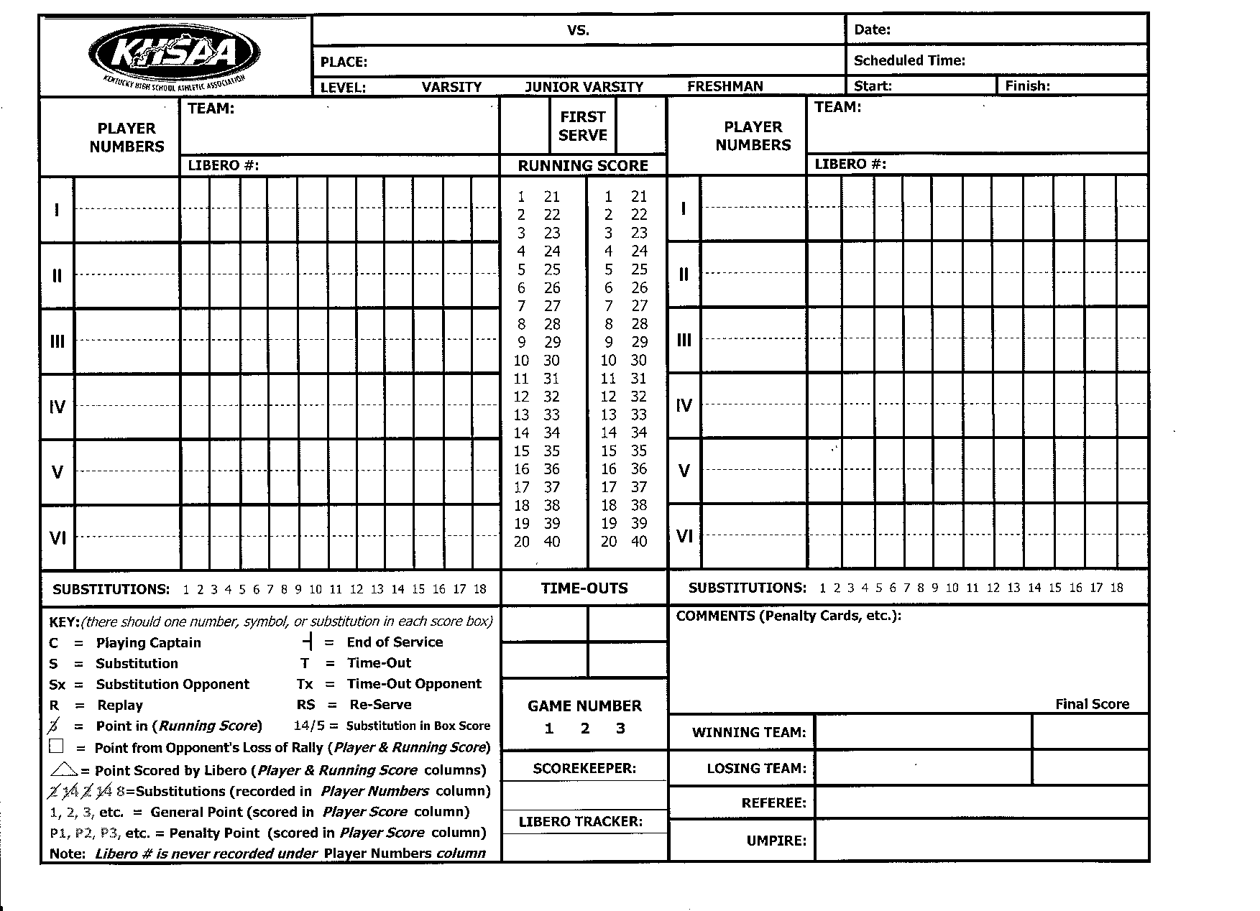






All notations during the rotation(s) using red pen/pencil are made in the same color plus time outs, substitutions, comments and points in running score column. [When using black/blue, all notations are in black/blue]. Home calls a time out at 20-20. Visitor delays returning to the court after the time out when whistled by R2 and is issued a YUD.
Visitor Home
Home High
9-23-2022
7:30 pm
7:30 pm
Home
30
Visitor
7
1 2 3 -l 20 -l
X
5
4
3 ,13,3
12c
11
10
23,25 ¹ -l
24c
26
20
21,33
22
20 T
21-l
Sx
R ₅ ₆ 25/23 7 8 P-l
-l
4
Sx
P2
3 4 5 6 7 8 -l
Tx 13/3
9
9 10 11 RS P12 Tx 13 -l
10 1112 13 -l
14 -l
15 161718 -l
19 -l
14
S
-l
Sx 3/1315 33/21
16 17 18 19 -l
8 - 5
9-12
20-20
RC #3 Visitor(8-1), YC #12 Visitor(8-8),
RC #12 Visitor (9-11) YUD Visitor 20-20
2 3 4 5
Penny Points
Laura Line Judge
Lenny Line Judge
Wanda Whistle
Tom Toots
Sally Spots

Slide 39







The set has continued and #24 for Home is serving, scoring 2 points – Visitor calls a time out which is an illegal time out, resulting in a RUD being awarded
to Home (P25 - remember to circle the point). The next serve is a loss of rally.
Visitor Home
Home High
9-23-2022
7:30 pm
7:30 pm
Home
30
1 -l 20 T 21 -l
Visitor
7
1 2 3 -l 20 -l
X
5
4
3 ,13,3
12c 10 1112 13 -l
11
10
23,25
24c
26
20 14 -l
21,33 15 16 17 18-l
22 19 -l
5 6 25/23 7 8 ^{P}
Sx
6 7 8 -l
4
R
Sx
-l21 22 23
3 4 5 13/3
P2
Tx
24 -l
22 2324 ^{P25} -l
9
-l 25
9
10 11 RS^{P12} Tx 13 -l
14
^{S} 15
Sx 33/21
-l
3/13
16 17 18 19 -l
8 - 5 20-20
9-12
RC #3 Visitor(8-1), YC #12 Visitor(8-8),
RC #12 Visitor (9-11) YUD Visitor 20-20.
RUD Visitor 24-24
2 3 4 5
Penny Points
Laura Line Judge
Lenny Line Judge Wanda Whistle
Tom Toots
Sally Spots

Slide 40

Visitor serves a loss of rally - Home serves set point.
Visitor
Home High
Home
9-23-2022
7:30 pm
7:30 pm
Home
30
1 _{-l} 20 T 21 -l
Visitor
7
1 2 3 -l 20 -l
X
5
4
3 ,13,3
12c 10 1112 13 -l
11
10
23,25
24c
26
20 14 -l
21,33 15 16 17 18 -l
22
5 6 25/23 7 8 ^{P}
Sx 13/3
6 7 8 -l
4
R
Sx
-l21 22 23
P2
3 4 5
Tx
24 -l
22 2324 ^{P25} -l
9
-l 25 -l
9
10 11 RS ^{P12} Tx 13 -l
26 27
14
^{S} 15
Sx 33/21
-l
3/13
16 17 18 19 -l
19
-l
8 - 5 20-20
9-12
RC #3 Visitor(8-1), YC #12 Visitor(8-8),
RC #12 Visitor (9-11) YUD Visitor 20-20.
RUD Visitor 24-24
2 3 4 5
Penny Points
Laura Line Judge
Lenny Line Judge
Wanda Whistle
Tom Toots
Sally Spots

Slide 41
Remember a set is to 25 win by 2 points.
The set is complete. Enter the Finish Time of the set
Visitor
Home High
Home
9-23-2022
7:30 pm
7:30 pm
Home
30
1 -l 20 T 21 -l
8:02pm
Visitor
7
1 2 3 -l 20 -l
X
5
4
3 ,13,3
12c 10 1112 13 -l
11
10
23,25
24c
26
20 14 -l
21,33 15 16 17 18 -l
22
5 6 25/23 7 8 ^{P}
Sx
6 7 8 -l
4
R
Sx
-l21 22 23
3 4 5 13/3
P2
Tx
24 -l
22 2324 ^{P25} -l
9
-l 25 -l
9
10 11 RS ^{P12} Tx 13 -l
26 27
14
^{S} 15
Sx 33/21
-l
3/13
16 17 18 19 -l
19
-l
8 - 5 20-20
9-12
RC #3 Visitor(8-1), YC #12 Visitor(8-8),
RC #12 Visitor (9-11) YUD Visitor 20-20.
RUD Visitor 24-24
2 3 4 5
Penny Points
Laura Line Judge
Lenny Line Judge
Wanda Whistle
Tom Toots
Sally Spots

Slide 42

Fill in the Winning Team, Losing Team and Correct Scores Make sure the referee and umpire names are filled in.
Visitor
Home High
Home
9-23-2022
7:30 pm
7:30 pm
Home
30
1 _{-l} 20 T 21 -l
8:02pm
Visitor
7
1 2 3 -l 20 -l
X
5
4
3 ,13,3
12c 10 1112 13 -l
11
10
23,25
24c
26
20 14 -l
21,33 15 16 17 18 -l
22
5 6 25/23 7 8 ^{P}
Sx
6 7 8 -l
4
R
Sx
-l21 22 23
3 4 5 13/3
P2
Tx
24 -l
22 2324 ^{P25} -l
9
-l 25 -l
9
10 11 RS ^{P12} Tx 13 -l
26 27
14
^{S} 15
Sx 33/21
-l
3/13
16 17 18 19 -l
19
-l
8 - 5 20-20
9-12
RC #3 Visitor(8-1), YC #12 Visitor(8-8),
RC #12 Visitor (9-11) YUD Visitor 20-20.
RUD Visitor 24-24
Home Visitor
2 3 4 5
27
25
Wanda Whistle
Tom Toots

Slide 43


Be sure the Scorer and Libero Tracker names are on the score sheet plus the Line Judges.
Visitor
Home High
Home
9-23-2022
7:30 pm
7:30 pm
Home
30
1 _{-l} 20 T 21 -l
Sx
8:02pm
Visitor
7
1 2 3 -l 20 -l
X
5
4
3 ,13,3
12c 10 1112 13 -l
11
10
23,25
24c
26
20 14 -l
21,33 15 16 17 18 -l
22
5 6 25/23 7 8 ^{P}
6 7 8 -l
4
R
Sx
-l21 22 23
P2
3 4 5
Tx
13/3
24 -l
22 2324 ^{P25} -l
9
-l 25 -l
9
10 11 RS ^{P12} Tx 13 -l
26 27
14
^{S} 15
Sx 33/21
-l
3/13
16 17 18 19 -l
19
-l
8 - 5 20-20
9-12
RC #3 Visitor(8-1), YC #12 Visitor(8-8),
RC #12 Visitor (9-11) YUD Visitor 20-20.
RUD Visitor 24-24
Home Visitor
Laura Line Judge
Lenny Line Judge
Wanda Whistle Tom Toots
2 3 4 5
27
25
Penny Points
Sally Spots

Slide 44
The R2 initials the score sheet at the end of each set and at the end of match.
Visitor
Home High
Home
9-23-2022
7:30 pm
7:30 pm
Home
30
1 _{-l} 20 T 21 -l
Sx
8:02pm
Visitor
7
1 2 3 -l 20 -l
X
5
4
3 ,13,3
12c 10 1112 13 -l
11
10
23,25
24c
26
20 14 -l
21,33 15 16 17 18 -l
22
5 6 25/23 7 8 ^{P}
6 7 8 -l
4
R
Sx
-l21 22 23
P2
3 4 5
Tx
13/3
24 -l
22 2324 ^{P25} -l
9
-l 25 -l
9
10 11 RS ^{P12} Tx 13 -l
26 27
14
^{S} 15
Sx 33/21
-l
3/13
16 17 18 19 -l
19
-l
8 - 5 20-20
9-12
RC #3 Visitor(8-1), YC #12 Visitor(8-8),
RC #12 Visitor (9-11) YUD Visitor 20-20.
RUD Visitor 24-24
Home Visitor
Laura Line Judge
Lenny LineJudge
Wanda Whistle Tom Toots
2 3 4 5
27
25
Penny Points
Sally Spots
TT

Slide 45
We are now ready to start set two of our match! Teams switch sides and HOME will serve first in the 2nd set.
~Remember, YC and RC carry over from set to set~
Visitor Home
Home High
9-23-2022
7:30 pm
Home
X
Visitor
RC #3 Visitor (8-1), YC #12 Visitor(8-8),
RC #12 Visitor (9-11)
2 3 4 5

Slide 46
Substitution &
Libero Procedures

Slide 47









REMEMBER: Substitution procedure takes place in FRONT of the 10’ line
SCOREKEEPER TABLE
BENCH
BENCH

Slide 48
Substitution procedure (multiple subs)
SCOREKEEPER TABLE
BENCH
BENCH
The first sub enters the sub zone.
The sub is authorized.
The second sub enters the sub zone.
The sub is authorized.
Play continues.

Slide 49






Libero procedure – takes place BEHIND 10’ line.
SCOREKEEPER TABLE
BENCH
BENCH

Slide 50
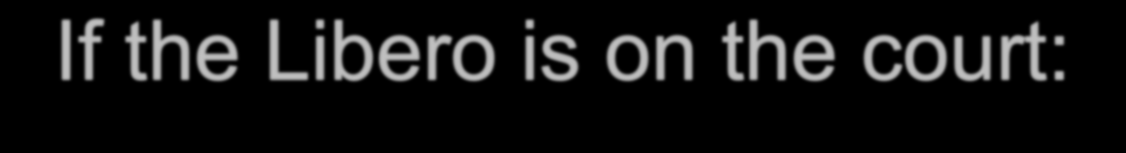





If the Libero is on the court: procedure for libero moving to serve
SCOREKEEPER TABLE
BENCH
BENCH

Slide 51
FOUR IMPORTANT LIBERO TRACKER RESPONSIBILITIES:
#1 Make certain that once the libero is replaced, at least one rally must take place before the libero can replace another player UNLESS the next action of the libero is to legally serve the next rally.
#2 When the libero leaves the court, ensure the player replacing the libero is the same player that the libero replaced when she last entered the game.
#3 Ensure that the libero does not rotate to the left-front position (front row) since the libero may only play a backrow position.
#4 Tell the R2 if the Libero is ‘IN’ or “OUT” for each team during time outs. NOTE: the Libero MAY NOT enter the court at the end of the time out unless she was “IN” prior to the time out being called.

Slide 52
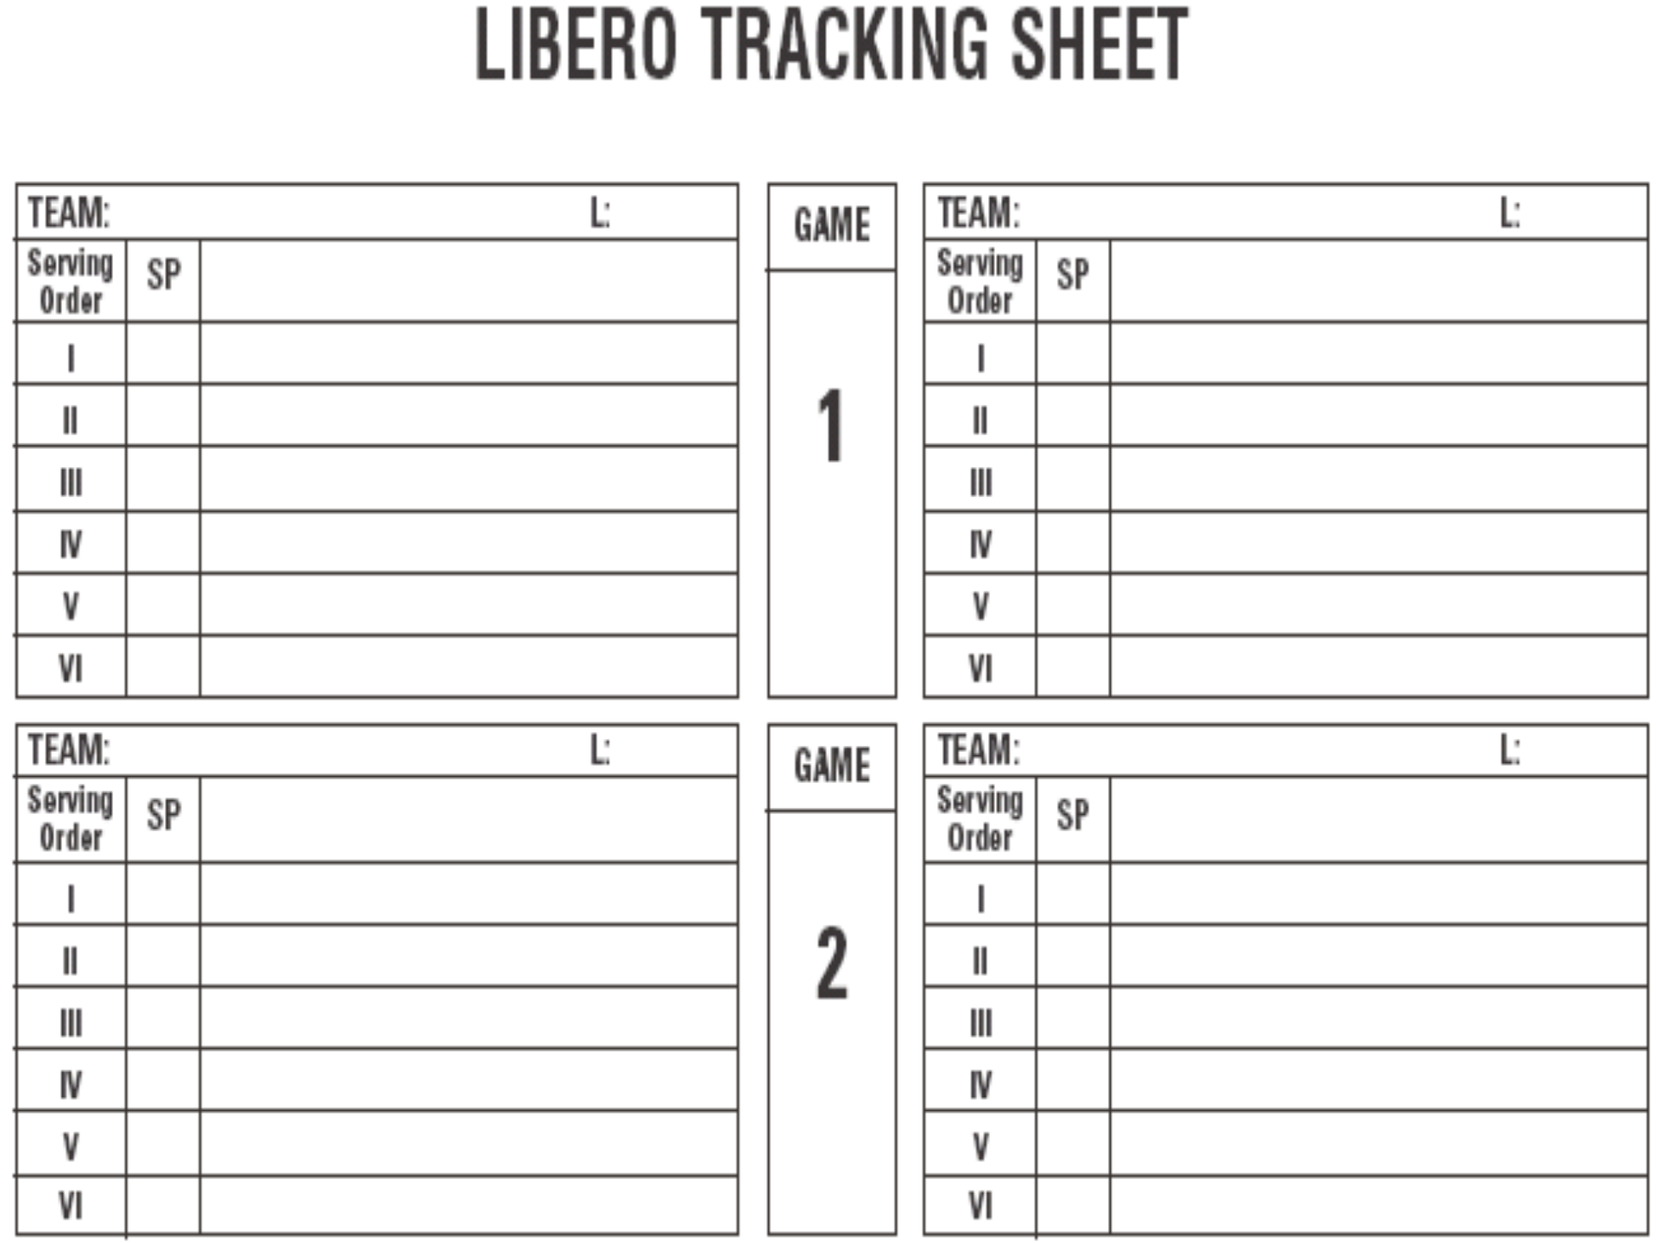
Visitor
7
Home
30
5
4
3
12c 11
10
23
24c 26
20
21
22
The lineups are entered on the Libero Tracking Sheet
the same as they are entered on the scoresheet.

Slide 53
Visitor
7
Home
30
5
4
3
12c 11
10
23
24c 26
20
21
22
25
13
The lineups are entered on the Libero Tracking Sheet
the same as they are entered on the scoresheet
The Libero Tracker tracks the Libero replacements and all substitutions. For example, if Home requests a substitution, #25 for #23, the libero tracker would record that action by slashing the “23” and writing a “25” immediately to the right of the of the slashed “23”.

Slide 54
Visitor
7
Home
30
5
4
3
12c 11
10
23
24c 26
20
21
22
25
13
L
The lineups are entered on the Libero Tracking Sheet
the same as they are entered on the scoresheet
After the next rally, the Home Libero, #30, replaces #26.
This exchange is recorded in a similar fashion, except an “L” used to indicate the libero’s entry.

Slide 55
Visitor
7
Home
30
5
4
3
12c 11
10
23
24c 26
20
21
22
25
13
L 26
Only #26 may re-enter the game for the libero; a proper replacement results in the same number being entered on both the left and right of the “L” on the tracking sheet.
The Libero Tracker must notify the second referee
immediately if an improper libero replacement occurs.

Slide 56
Visitor
7
Home
30
5
4
3
12c 11
10
23 25
24c 26
20
21
22
13
L 26
The Libero Tracker tracks the Libero replacements and all substitutions. For example, if East requests a substitution, #7 for #5, the libero tracker would record that action by slashing the “5” and writing a “7” immediately to the right of the of the slashed “5”.
After the next rally, the West Libero, #13, replaces #26. This exchange is recorded in a similar fashion, except an “L” used to indicate the libero’s entry.
Remember – the last numbers written on each line of the Libero Tracking Sheet should always reflect the six players that are currently on the court.
The lineups are entered on the Libero Tracking Sheet
the same as they are entered on the scoresheet

Slide 57
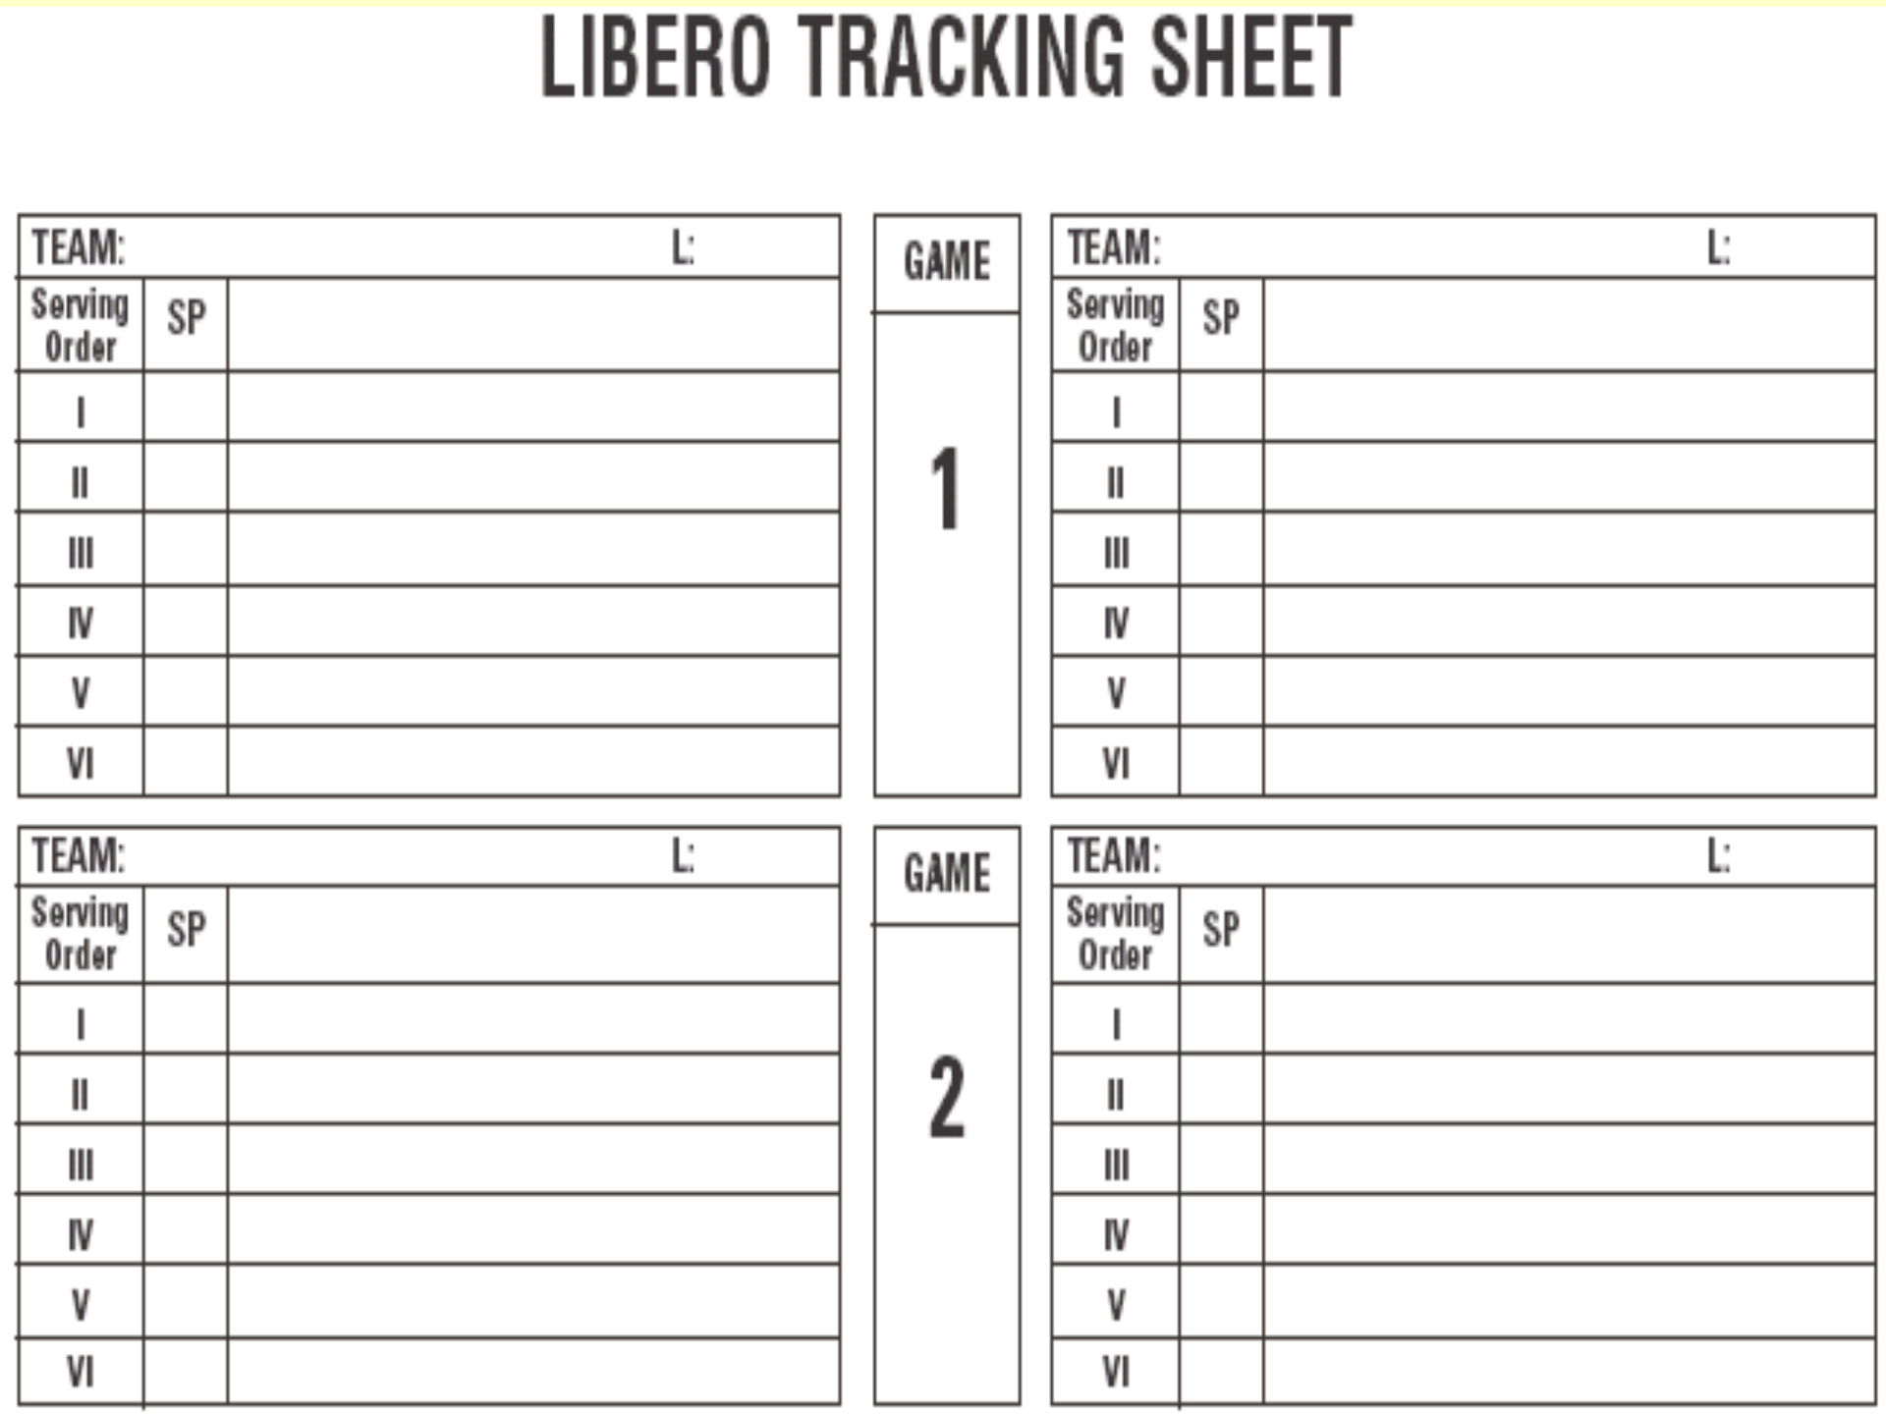
Visitor
7
Home
30
5
4
3
12c 11
10
25
23
24c
26 L 26 L 20
21
22
13
In addition to recording the libero replacement, the libero tracker must note the serving position of the libero to help ensure that the libero only serves in one position per set.
When a libero contacts the ball to serve, a triangle is drawn around the corresponding Roman numeral in the “Serving Order” column to note the only service position where the libero can serve for the remainder of that particular set.

Slide 58
~REMEMBER~
Notify the officials if the libero is replaced by an incorrect player, or if an undesignated libero enters the game.
Notify the officials if the libero does not remain out of the game for one rally between replacements unless the libero is legally able to serve the next rally, having been replaced by the player whom the libero last replaced and with the player who would have served the next rally exiting through the libero replacement zone.
Notify the officials if the libero contacts the serve from another position in the serve order during the same set.

Slide 59
Q: What if a team does not have a Libero?
~~No tracking will take place for that team J
NOTE- A different libero may be designated for each set, but the
designation must be made on the lineup sheet when it is submitted to the R2 before each set.

Slide 60
