Slide 1
2019 contrasting Uniform Top Requirements

Slide 3
Rule 4-2-1 Reorganization
Legal Uniform

Slide 4
Rule 4-2-1 Legal Uniform
ART.1…All uniforms shall adhere to the following:
Uniform tops [with the exception of the libero (4-2-2)] and bottoms shall be like-colored.
Uniforms shall be worn as the manufacturer intended.
Uniforms shall be free of hard and unyielding items (buttons, zippers, snaps, fasteners, etc.).
A single, visible manufacturer's logo and/or single school name or insignia no more than 2 1/4 inches are permitted on each visible undergarment.
The school’s name, nickname, logo, mascot and/or team member’s name are permitted on the uniform top and/or bottom. A single mascot reference and/or school name may be placed on the sleeve(s), not to exceed either 4 by 4 inches or 3 by 5 inches.

Slide 5
Rule 4-2-1 Legal Uniform
f. A single partial/whole manufacturer's logo/trademark/reference, no more than 2 ¼ square inches with no dimension more than 2 ¼ inches, is permitted on each piece of the uniform provided placement does not interfere with the visibility of the player's number.
g. One American flag, not to exceed 2 by 3 inches may be worn or occupy space on each item of uniform apparel. By state association adoption, to allow for special occasions, commemorative or memorial patches, not to exceed 4 square inches may be worn on the uniform without compromising its integrity.

Slide 6
Rule 4-2-1 Legal Uniform
h. Uniform top:
Bare-midriff tops are not allowed.
The uniform top shall hang below or be tucked into the waistband of the uniform bottom when the player is standing upright.
Any visible garment (t-shirt, body suits and other similar garments) worn underneath the uniform top shall be unadorned and of a single, solid color that is similar in color to the predominant color of the uniform top.
i. Like-colored uniform bottom:
Multiple styles of uniform bottoms may be worn by teammates and may include: shorts, spandex, pants or skirts.
A visible undergarment may be worn under the uniform bottom. It shall be unadorned and of a single solid color similar to the predominant color of the uniform bottom and may extend below the uniform bottom.

Slide 7
Rule 4-2-2 Elimination of the Solid-Colored Uniform Top Requirement
Legal Uniform

Slide 8
4-2-2 Contrasting libero Uniform Requirements
ART 2…The libero uniform top must clearly contrast from the predominant color(s) of the team uniform top, excluding trim. The libero‘s uniform top cannot be made up solely of the same predominant color(s) of the team’s uniform top, even if the like color(s) are placed differently on the uniform top. Numbers shall meet all specifications in Rule 4-2-4.
The libero must clearly contrast with the rest of his/her teammates and conform to all other uniform rules.
All currently compliant libero uniforms will maintain compliance under new rule.

Slide 9
Establishing Predominant Colors
Predominant color(s) is the color(s) appearing on the majority of the uniform top (body and sleeves).
Uniform tops can have one predominant color with accent colors (colors used in designs or trim).
When one predominant color can be established any of the accent colors, if clearly contrasting, can be used as the predominant color of the libero uniform top.

Slide 10
Team/Libero Uniform Compliance – Predominant colors
In this scenario, the uniform has one predominant color: BLACK

Slide 11
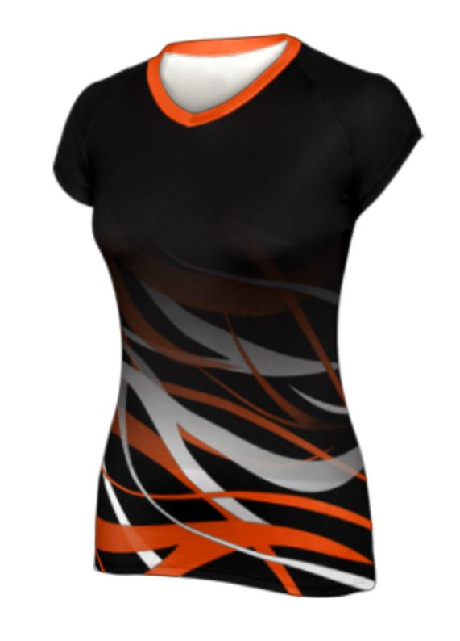
Team/Libero Uniform Compliance – Predominant colors
Since the uniform has one predominant color (BLACK) any contrasting color can be used as the predominant color of the libero uniform and black can be used as an accent color.
Compliant

Slide 12
Establishing Predominant Colors
Uniform tops can have multiple predominant colors sharing approximately the same amount of space on the uniform top.
When multiple predominant colors can be established neither of the predominant colors can be used as the predominant color of the libero uniform top, even if placed differently on the uniform top.

Slide 13
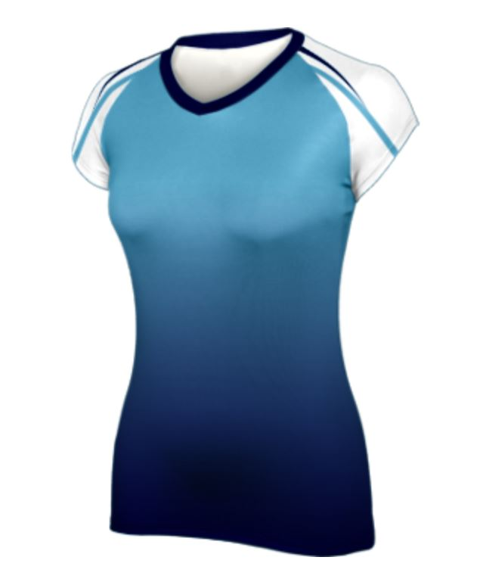
Team/Libero Uniform Compliance – Predominant colors
In this scenario, the uniform has two predominant colors: light blue and navy blue.

Slide 14
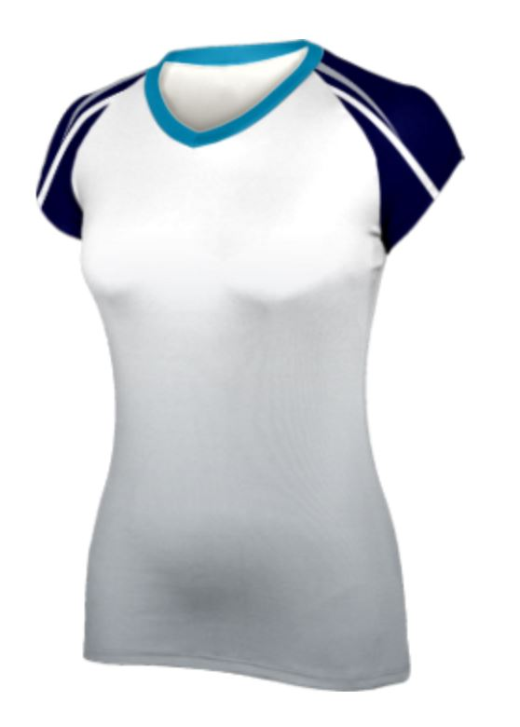
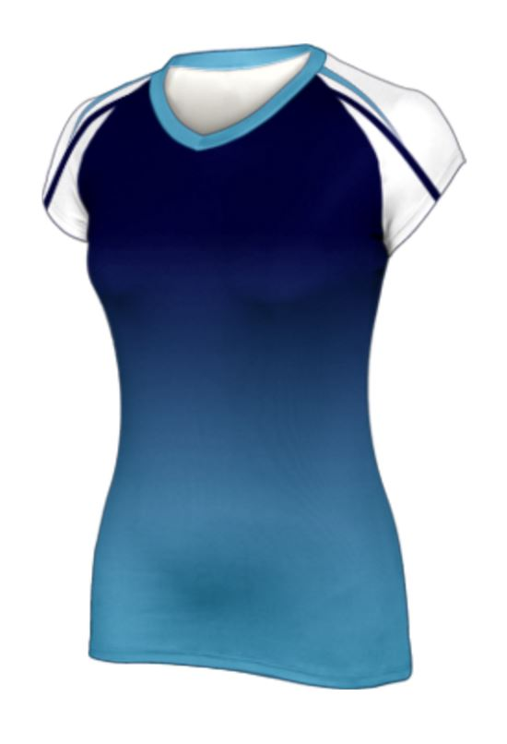
Team/Libero Uniform Compliance – Predominant colors
Which one of the jerseys below would be a compliant libero jersey?
Compliant
Non-compliant
Team Jersey

Slide 15
Establishing Predominant Colors
In all scenarios when there is more than one prevailing uniform color, both colors are to be determined as prominent colors and neither should be used as the predominant color(s) of the libero uniform.

Slide 16
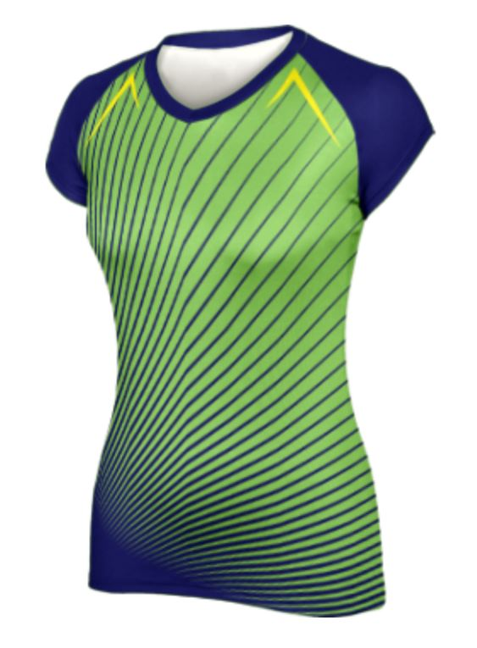
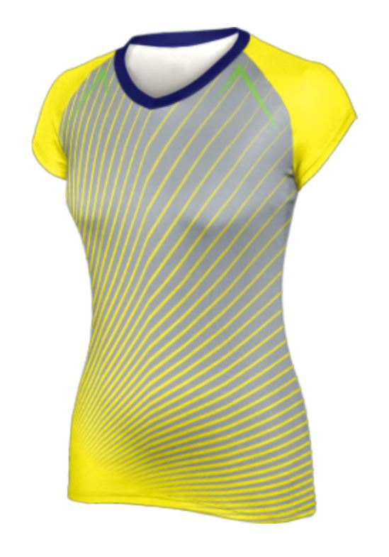
Team/Libero Uniform Compliance – Predominant colors
Which one of the jerseys below would be a compliant libero jersey?
Non-compliant
Compliant
Team Jersey

Slide 17
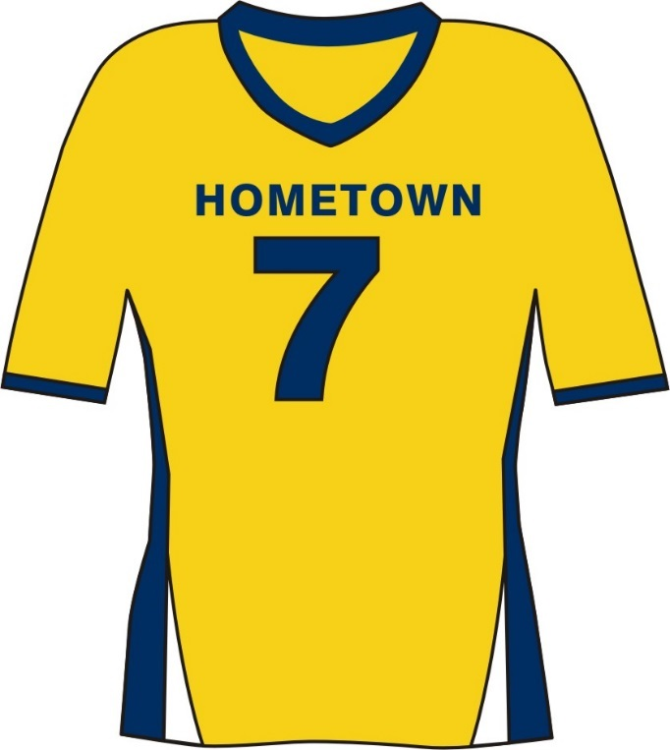
Team/Libero Uniform Compliance – Piping/Trim
Piping/trim does not need to be placed on a seam.
There are no width requirements for piping/trim.
The contrasting libero uniform can be blue or white or any other contrasting color.
Compliant
Seam
Accent on seam and no wider than 1”
Trim too wide 3”

Slide 18
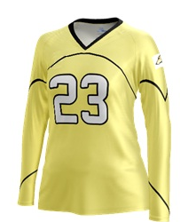
Team/Libero Uniform Compliance – Piping/Trim
Sublimation vs. seams – Both are compliant
Does the grey jersey contrast with the yellow jersey?
Compliant

Slide 19
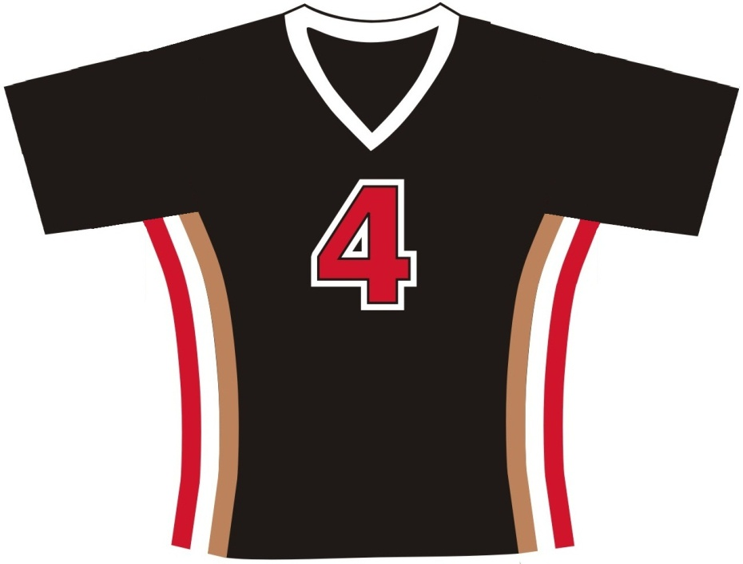
Team/Libero Uniform Compliance – Piping/Trim
Trim (red, white and gold) is wider than 1 inch in total width
Compliant
Libero/team jersey can be red, white or gold (any contrasting color to black).

Slide 20
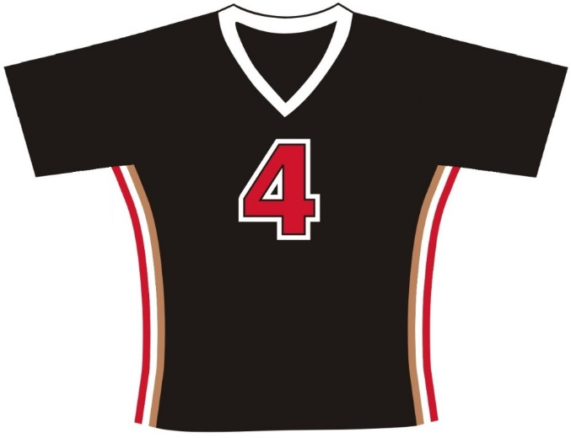
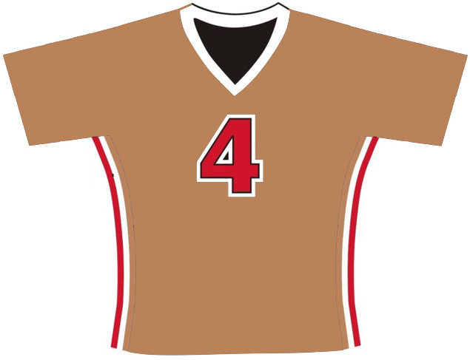
Team/Libero Uniform Compliance – Piping/Trim
Are these uniforms clearly contrasting?
YES
Compliant

Slide 21
Team/Libero Uniform Compliance – School References
School mascot references
Compliant

Slide 22
Team/Libero Uniform Compliance – School References
Is the mascot permitted on the jersey of both the team and the libero?
A yellow jersey with a yellow and purple mascot on the uniform would be compliant and contrasting.
Compliant

Slide 23
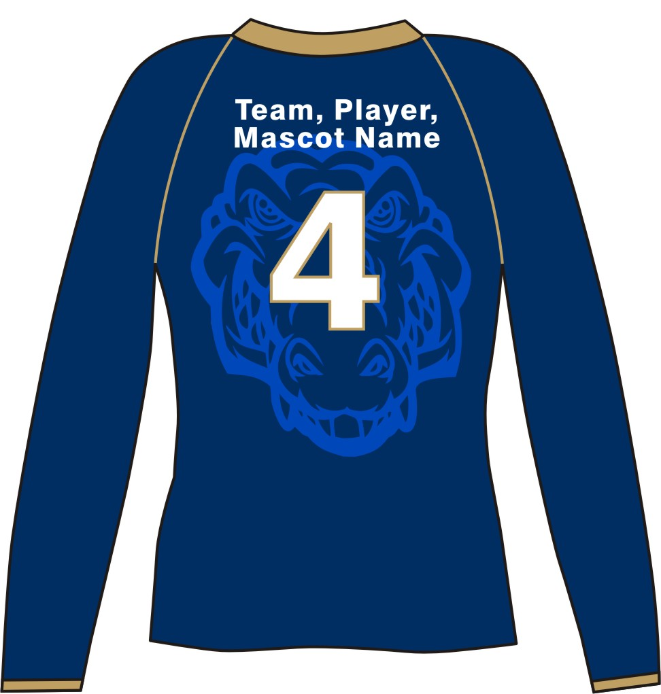
Team/Libero Uniform Compliance – School References
Can you clearly see the uniform number? (4-2-4a)
The sublimated team mascot is compliant on both the team and libero jersey.
A gold uniform with the sublimated mascot would be a compliant contrasting jersey.
Compliant

Slide 24
Coming in 2023…

Slide 25
Rule 4-2-4c
ART. 4…The number shall be:
c. A plain, Arabic numeral of a solid, clearly contrasting color from the body of the uniform.
While currently compliant, the white number on the white jersey with the contrasting border will be non-compliant in 2023.

Slide 26
Legal Uniform
All other uniform requirements as set forth in the NFHS Rules Book must be met for a uniform to be legal.
Questions regarding uniforms should be directed to the state association. All state association questions can be directed to Lindsey Atkinson.
Lindsey Atkinson
Director of Sports
E-mail: latkinson@nfhs.org
National Federation of State High School Associations
P.O. Box 690
Indianapolis, IN 46206
Phone: 317-972-5730

